Slide 1
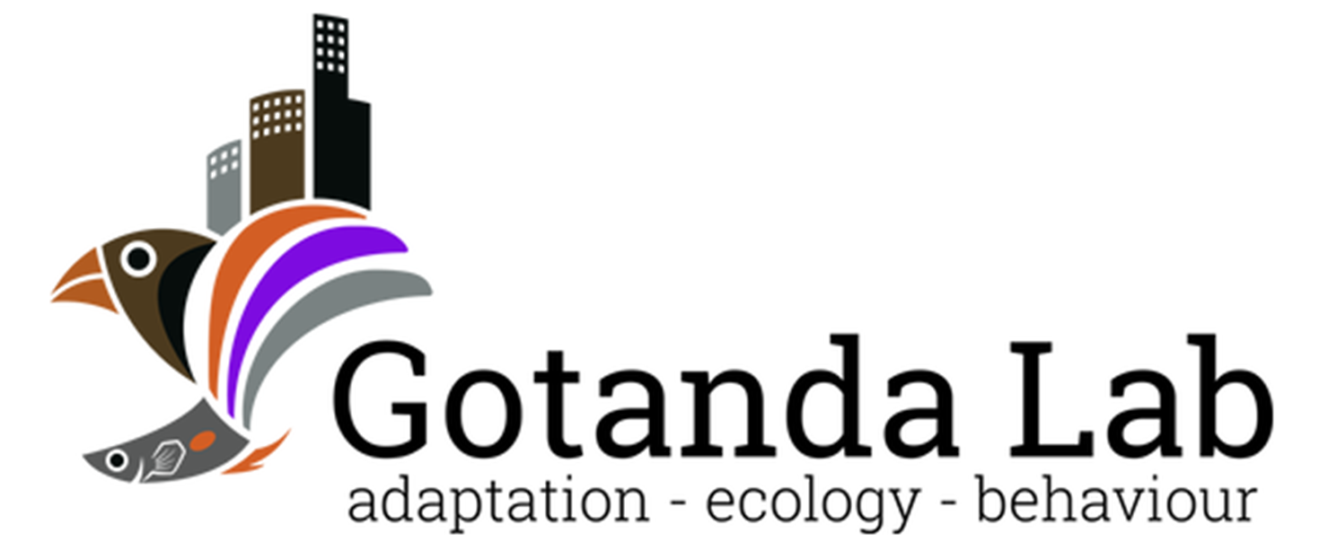

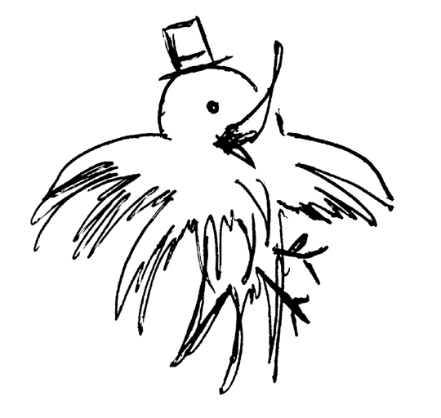
Heads Up!
Social Vigilance Behavior in American Crows
Alex Popescu, Dr. Anne B. Clark, Dr. Kiyoko M. Gotanda
Adapted from the GRaD 2023 Presentation
Brock University

Slide 2


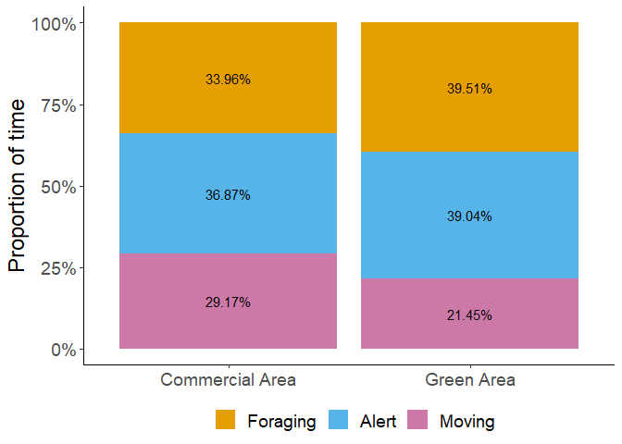



Proportion of time
No significant effects of generalized environment (p = 0.989).
If not the proportion, could it be the duration of bouts that change?

Slide 3
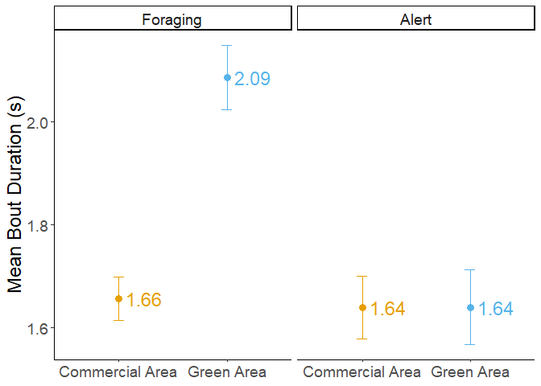
Bout Duration
Foraging:
- Increased duration in green areas (p=<0.001).
Alert:
- No effect of generalized environment (p=0.965).

Slide 4
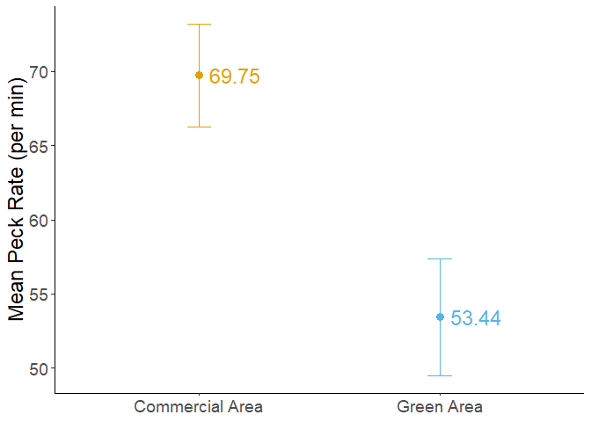
Peck rate
The generalized environment had a marginally significant effect (p = 0.076).

Slide 5
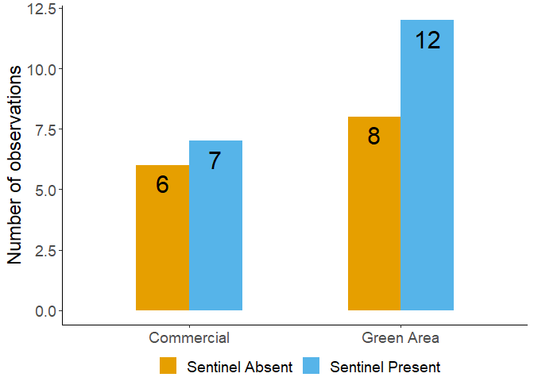
Likelihood of sentinel presence
No effect of generalized environment!

